Slide 1

PE 1 4.5 Creating and Organizing Functions
Programming Logic

Slide 2

Organizing with Functions
Everything in your code EXCEPT global variables, and a comment explaining the program purpose should be in functions
Each function needs at least 1 comment
Main should be used in every program to organize other functions
Main should be the last function
Don’t forget to call main

Slide 3
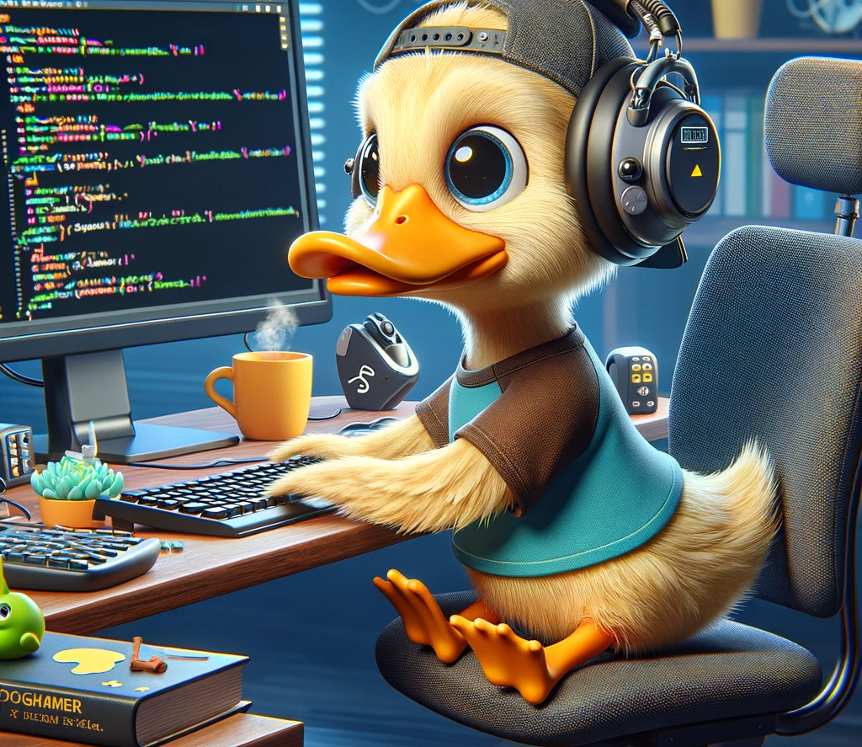
Using Functions
Main organizes the functions
Other functions should only accomplish 1 task each:
get information
Calculate
Print
This makes them reusable and better organizes your code

Slide 4

Best Practices
Best Practices
Use meaningful names
Pass variables, don’t use globals except for constants
Organize well
Document each function with at least one comment
Avoid shadow errors!! (using a function name and a variable name that are the same)

Slide 5
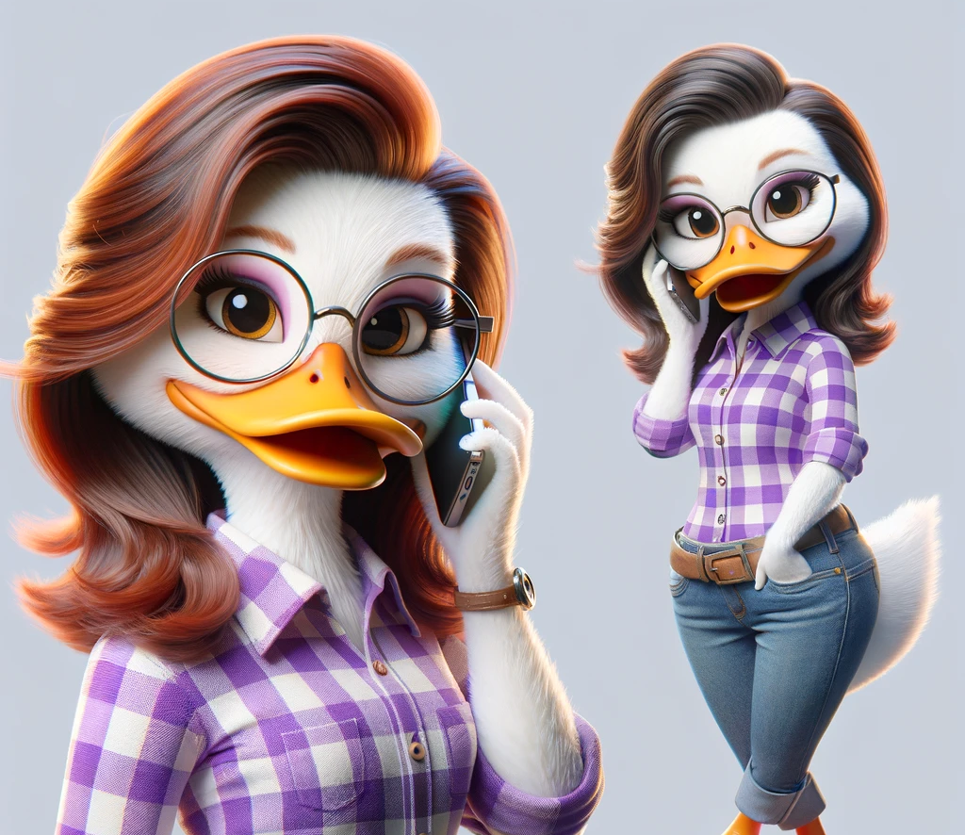
Recursive calls
A function that calls itself
Not needed, but can be useful
Tested on certification
Can pass variables to itself
It is a special loop, like a while needs a condition to end or will enter an infinite loop
Infinite loop = stack overflow errors

Slide 6
Sample code
def double_penny(days, amount=0.01):
if days == 1:
return amount
else:
return double_penny(days - 1, amount * 2)
def main():
days = int(input("Enter the number of days: "))
total_amount = double_penny(days)
print(f"Total amount after {days} days: ${total_amount:,.2f}")
main()

